Slide 1

Light & Mandap Decoration System
Software Project - 2
SEM-4
Guided By :-
Prof. Punita mam
Chandresh Dhaduk:-F-2
Sathvara Krishna :-F-12

Slide 2
Need for the new system
The demand for an online light and mandap decoration system has arisen from the need for efficiency, convenience, and seamless integration of modern technology into event planning. In a fast-paced world, where time is of the essence, an online system offers a solution that streamlines the entire process of light and mandap decoration. By leveraging digital platforms, users can access a diverse array of customizable options, enabling them to plan and visualize their desired decor remotely. This online system not only provides a user-friendly interface for designing personalized setups but also facilitates quick decision-making with instant access to a vast repository of themes, color palettes, and decor elements. Furthermore, it offers the flexibility to make real-time adjustments and updates, ensuring that the decor aligns perfectly with the evolving vision for the event.

Slide 3
Objective of the new system
1.Efficiency Improvement:
2.Enhanced Customer Experience:
3.Online Booking and Accessibility:
4.Real-Time Availability Management:
5.Secure Payment Processing:
6.Adaptability and Scalability:
01

Slide 4
Problem Definition
“Inefficient manual processes for event light & mandap decoration prompts the need for an automated digital a system ensuring seamless coordination.”
YOUR TITLE HERE
We have many PowerPoint templates that has been specifically designed to help anyone that is stepping into the world of PowerPoint for the very first time.

Slide 5
Core Components
1.Inventory Management:
•
2.Event Scheduler:
•
3.Theme Designs:
•
4.Packages:
5.Booking:
6.Report Generate:
7.Feedback System:
8.Employee Management:
9.Security Measures:
10.Payment:

Slide 6
Project Profile
Project Title: - | Light & Mandap decoration website
Institute Name: - | L J Institute of Computer Application.
Purpose: - | To develop a website to manage the light and mandap for weddings and parties.
Team Size: - | 2
Team Members: - | Chandresh Dhaduk (02) Krishna Sathvara (12)
Project Guide: - | Pro. Punita Mam
Front-end Technology: - | HTML, CSS, JavaScript.
Back-end Technology: - | PHP
Database: - | MYSQL Database
Server:- | Xampp

Slide 7
Assumptions and constraints
Assumptions:
1. Decoration services:
2. User-Friendly Interface:
3. Booking and Scheduling:
Constraints:
1. Internet Connectivity:
•2. Security Concerns:
•3. Regulatory Compliance:
•4. Customization Limitations:

Slide 8
Advantages and limitations of the system
Advantages:
1. Convenience:
• 2. Wide Product Selection:
• 3. 24/7 Accessibility:
• 4. Time-Saving:
•
Limitation:
1. Lack of Physical Inspection:
2. Security Concerns:
3. Inability to Experience Products:
4. Security Concerns:

Slide 9
Requirement determination:
1.Inventory Management:
• 2. Booking system:
• 3. Cart and Checkout:
• 4. Payment Gateway Integration:
• 5.Social media integration:
6. User Reviews and Ratings:

Slide 10
Requirement Specification:
1. User Registration and Authentication:
• 2. Event management:
• 3. Package Selection and Customization:
• 4. Searching:
• 5. Product Details:
6. Order Management:
7. Vendor Management:
8. Security
9. Scalability:
10. Integration:
• 11. Support and Maintenance:
•

Slide 11
Targeted Users:
1.Event Planners:
• 2.Brides and Grooms:
• 3.Party Hosts:
• 4.Vendors:
• 5.Corporate Event Planner:
•

Slide 12
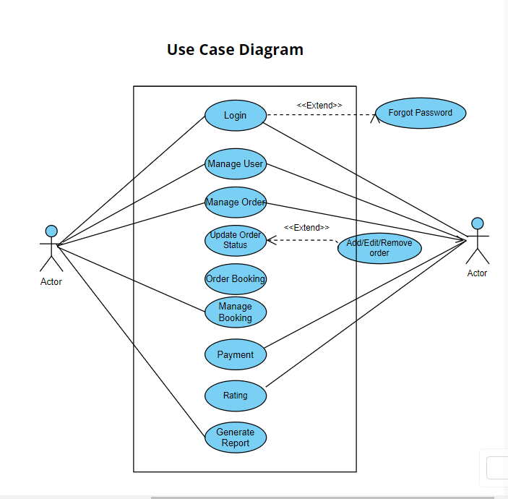
Use case Diagram

Slide 13
Data Dictionary
Ø Admin
FieldName | Type | Size | Constraint | SampleData
id | int | 11 | Not Null | 1
username | varchar | 255 | Not Null | admin
password | varchar | 255 | Not Null | Admin123

Slide 14
Ø Event Information:
FieldName | Type | Size | Constraint | SampleData
EvenrtID | int | 11 | Not Null | 1
date | date | 255 | Not Null | 27/2/2024
VenueID | int | 255 | Not Null | Identifier for the venue where the event takes place.
Event_type | String | 255 | Not Null | wedding
Client_name | String | 255 | Not Null | Rohit
Mandap_theme | String | 255 | Not Null | Theme chosen for the mandap decoration.
Lighting_type | String | 255 | Not Null | Type of lighting used for decoration.
Decoration_cost | Decimal | 255 | Not Null | 15000
NumberOFGuest | int | 255 | Not Null | 200+
DecorationStratDate | DateTime | 255 | Not Null | 24/2/2024
DecorationTeamLead | String | 255 | Not Null | Krishna

Slide 15
Ø Admin User Permissions:
Admin User Permissions:
FieldName | Type | Size | Constraint | SampleData
id | int | 11 | Null | 1
EventModificationPermissions | varchar | 255 | Null | Specific permissions related to modifying event data.
UserManagementPermissions | varchar | 255 | Null | Permissions related to managing other user accounts.
SystemLogsAccess: | varchar | 11 | Null | Permission to access and view system logs.

Slide 16
Ø Users
FieldName | Type | Size | Constraint | SampleData
id | int | 11 | NULL | 1
Username | varchar | 255 | NULL | Rohit
Password | varchar | 255 | NULL | user@123
Email | varchar | 255 | NULL | user@gmail.com
Contact_number | varchar | 255 | NULL | 9856478569
Address | varchar | 255 | NULL | Naroda
RegistrationDate | varchar | 255 | NULL | 27/02/2024

Slide 17
Ø Event Booking History
FieldName | Type | Size | Constraint | SampleData
Bookingid | int | 11 | Not null | 1
Eventid | String | 255 | Not null | 1
BookingDateTime | String | 255 | Default null | 27/02/2024
TotalAmountPaid | Email | 255 | Default null | 7000

Slide 18
Ø Payment Information
FieldName | Type | Size | Constraint | SampleData
paymentId | int | 11 | NULL | 1
UserId | varchar | 255 | NULL | 1
EventId | varchar | 255 | NULL | 27/02/2024
PaymentDatetime | varchar | 255 | NULL | 26/02/2024
PaymentAmount | varchar | 255 | NULL | 16000
PaymentMethod | varchar | 255 | NULL | COD
TransactionID | varchar | 255 | NULL | UPI

Slide 19
Ø Elegant Evening Package:
FieldName | Type | Size | Constraint | SampleData
package_id | int | 11 | NULL | 1
description | varchar | 255 | NULL | 1
Price | varchar | 255 | NULL | 27/02/2024
Duration | varchar | 255 | NULL | 26/02/2024
Items | varchar | 255 | NULL | 16000
Additional_services | varchar | 255 | NULL | COD
availability | varchar | 255 | NULL | UPI
Contract_information | varchar | 255 | NULL
Image | varchar | 255 | NULL

Slide 20
Ø Grand Mandap Package:
FieldName | Type | Size | Constraint | SampleData
package_id | int | 11 | NULL | 1
description | varchar | 255 | NULL | 1
Price | varchar | 255 | NULL | 27/02/2024
Duration | varchar | 255 | NULL | 26/02/2024
Items | varchar | 255 | NULL | 16000
Additional_services | varchar | 255 | NULL | COD
availability | varchar | 255 | NULL | UPI
Contract_information | varchar | 255 | NULL
Image | varchar | 255 | NULL

Slide 21
Ø Deluxe Lighting Package:
FieldName | Type | Size | Constraint | SampleData
package_id | int | 11 | NULL | 1
description | varchar | 255 | NULL | 1
Price | varchar | 255 | NULL | 27/02/2024
Duration | varchar | 255 | NULL | 26/02/2024
Items | varchar | 255 | NULL | 16000
Additional_services | varchar | 255 | NULL | COD
availability | varchar | 255 | NULL | UPI
Contract_information | varchar | 255 | NULL | details
Image | varchar | 255 | NULL | Package.jpeg

Slide 22
Coding Standart
1. File and Folder Structure:
2. Indentation and Formatting:
3. Comments:
4. Database Design:
5. Validation:
6. Error Handling:
7. Authentication and Authorization:
8. Version Control:
9. Documentation:

Slide 23
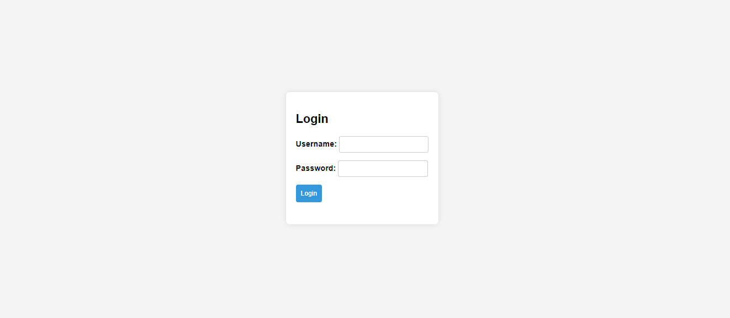
Screen Short

Slide 24
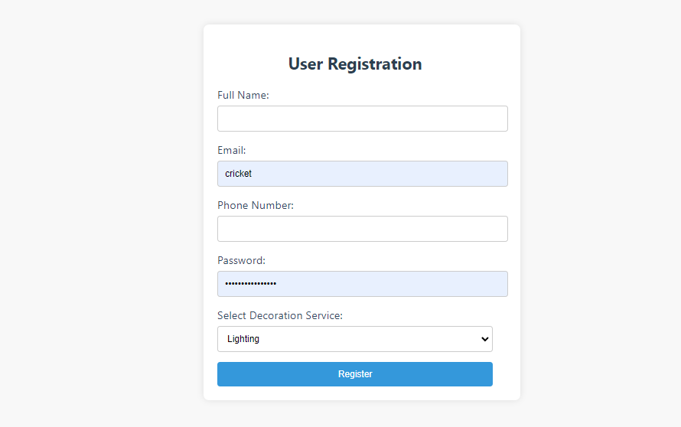

Slide 25
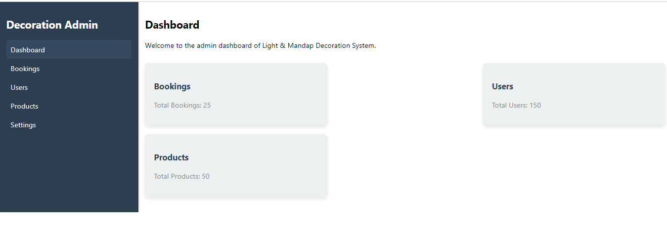

Slide 26
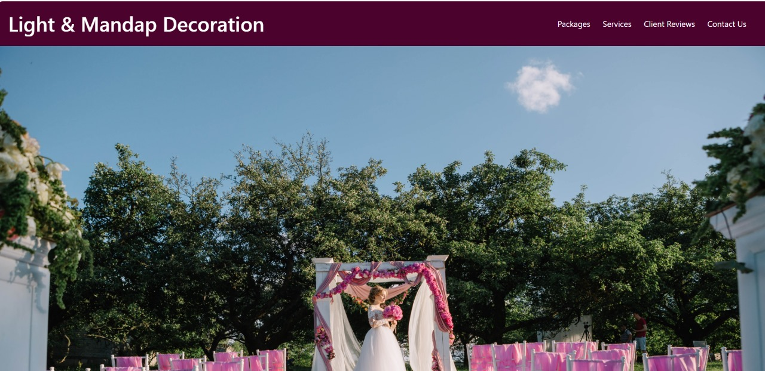
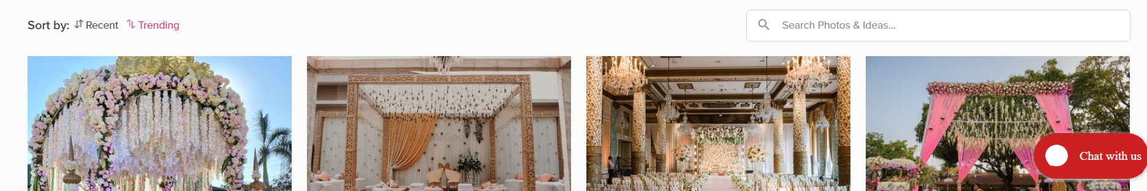

Slide 27
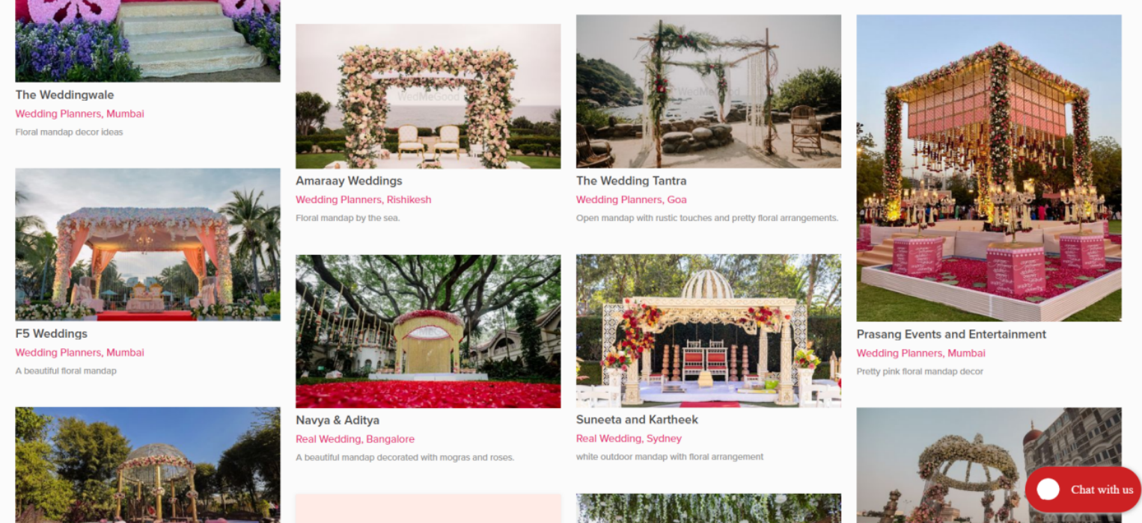

Slide 28
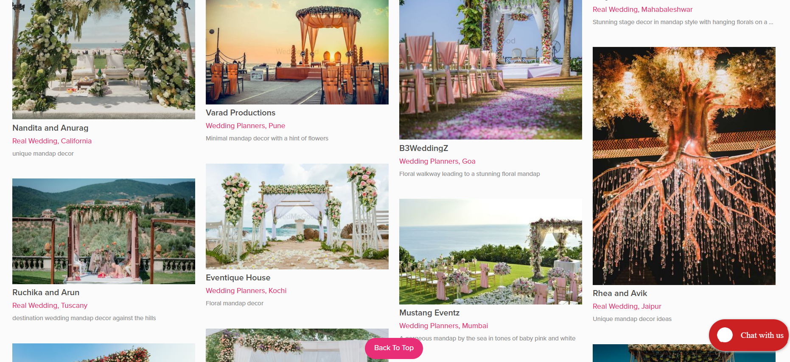

Slide 29
Agile Project Charter
General Project Information
Project Name | Shiv Light & Mandap Decoration
Project Champion | Chandresh Dhaduk
Project Sponsor | Dhaval Chaudhry
Project Manager | Krishna Sathvara
Stakeholders | Admin, Manager, User
Expected Start Date | 10-1-2024
Expected Completion Date | 10-4-2024

Slide 30
Project Details
Mission | our mission is to spread joy and happiness through the beauty of light and decoration, making every celebration a Memorable experience for all involved.
Vision | Stay updated with the latest trends and technologies in lighting and Decorationoffering innovative ideas and products to users.
Risk | Risks of electrical shock or fire due to faulty wiring or inadequate safety Measures.Damage to decorations or lighting systems due to exposure to harsh weatherConditions like rain, wind,or extreme temperatures.Impacton credibility due to unhappy customers.Concerns related to online transactions.Errors or misunderstandings in client interactions.
Success Metrics | Achieve a minimum 50+visitors to visit ourwebsite over a one month.Maintain average user rating of 4 star of above on customer feedback platform.Having a beautiful atmosphere and alluring decor is the best combination for a successful wedding occasion

Slide 31
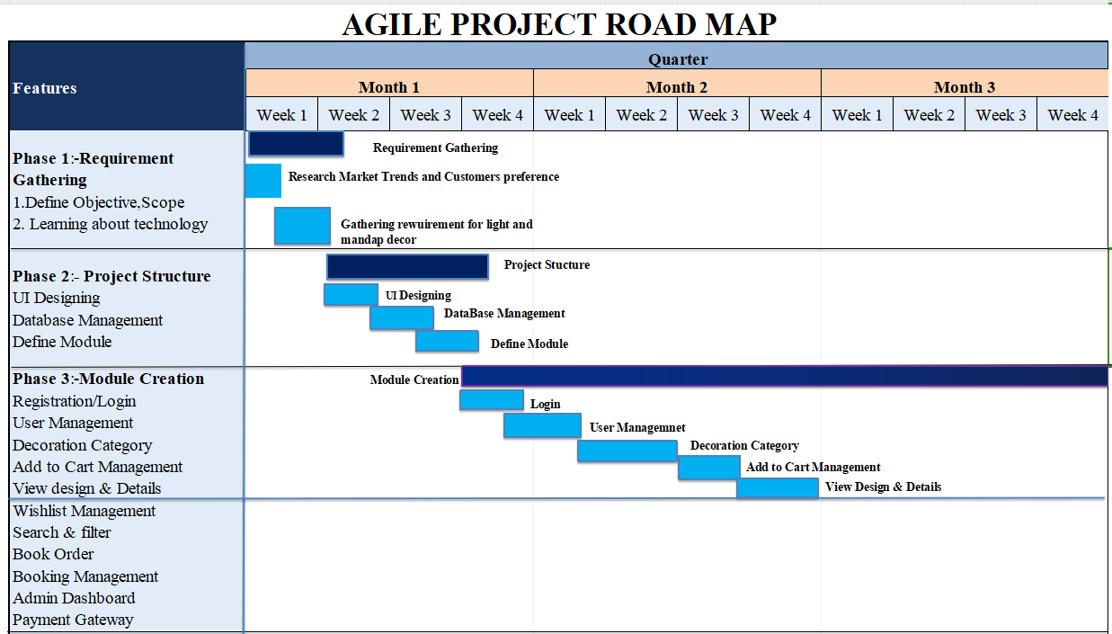
Agile Roadmap

Slide 32
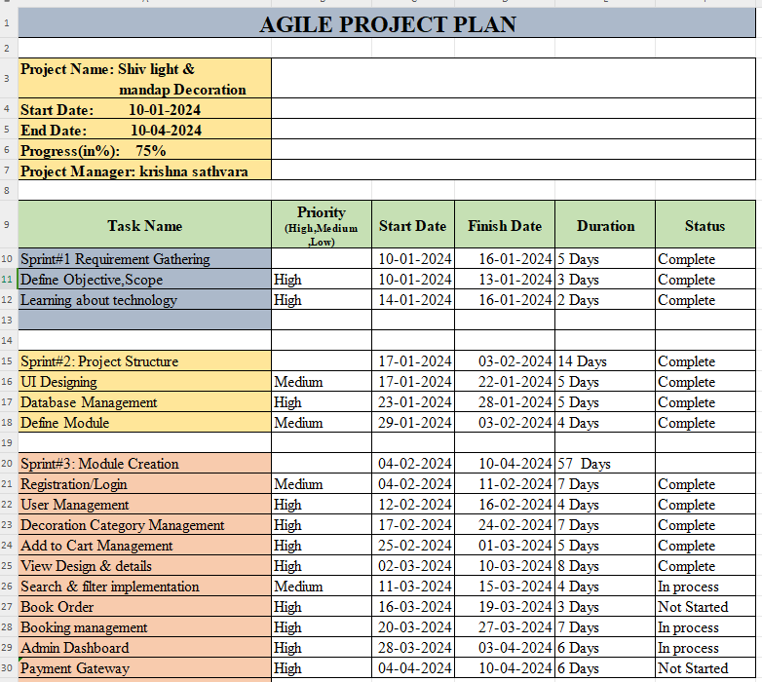
Agile Project Pan

Slide 33
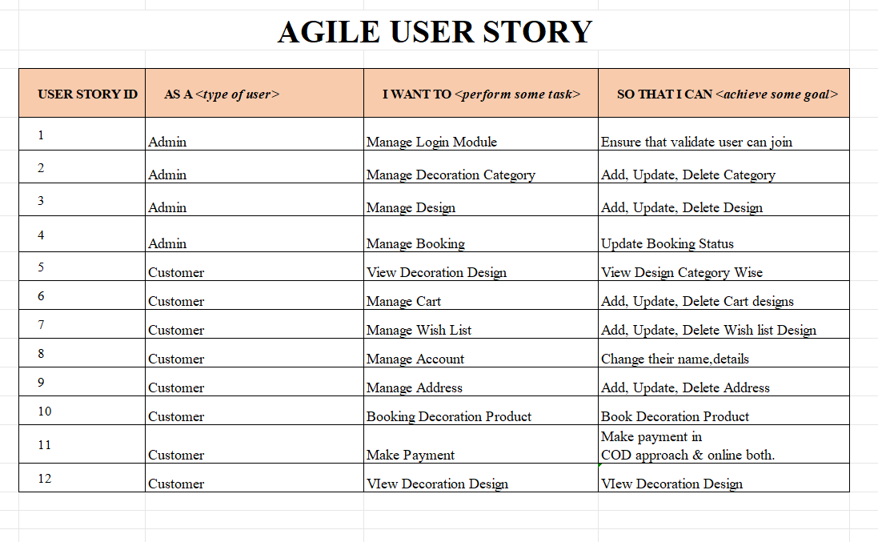
Agile User Story

